Slide 1
Crowned Jewelers: Conversion Funnel Analysis
-Priyanka Kadam

Slide 2
Crowned Jewelers Conversion Funnel From our conversion funnel, out of 2000 who landed on the home page,1591 were interested in learning more and chose a product category and 658 desired to buy an item from the chosen product categories.

Slide 3
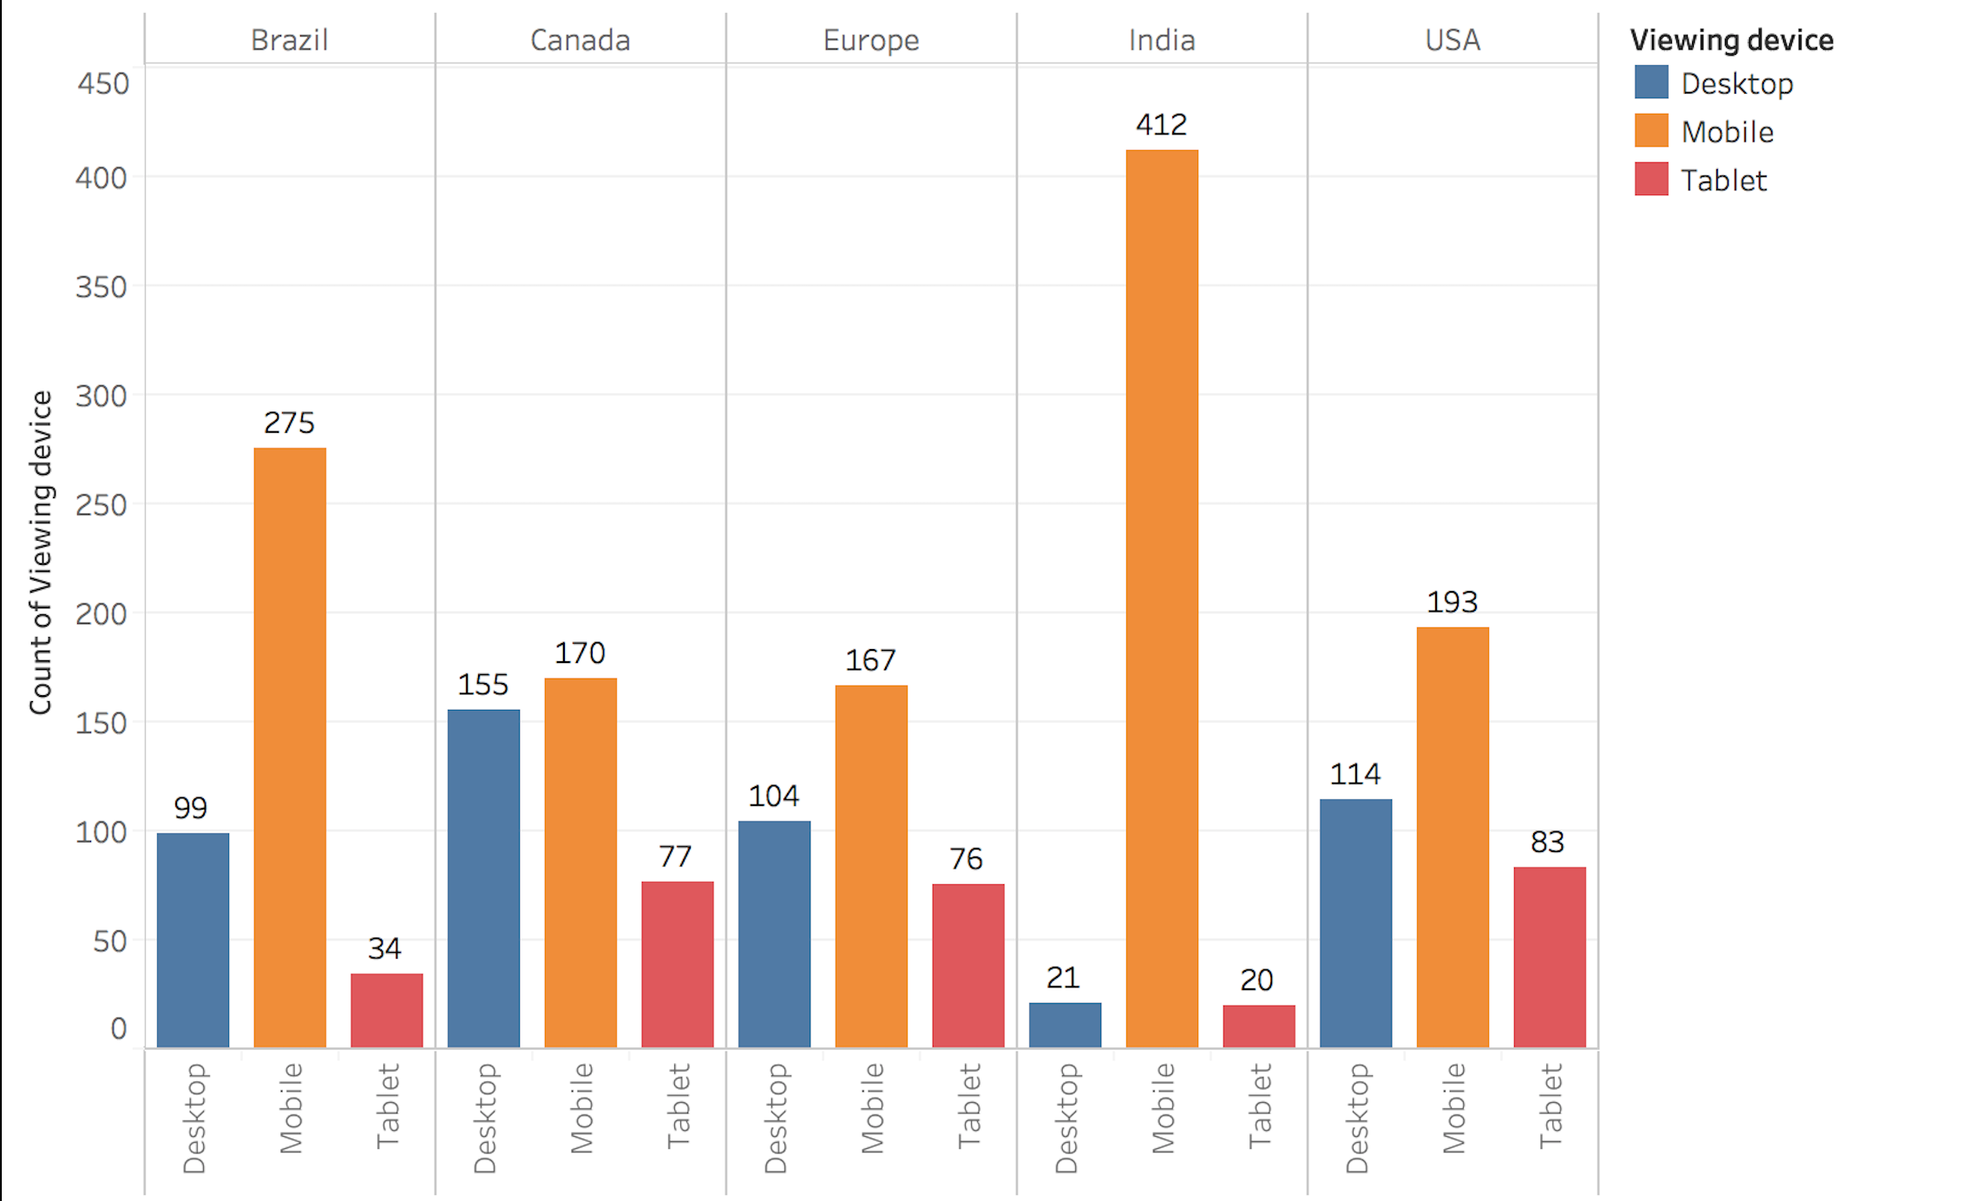
Device usage by region 1. From the data, Mobile is used more than Desktop and Tablet in all the regions as the viewing device to buy Jewelry. 2. Must pay special attention to mobile conversion optimization strategies.

Slide 4
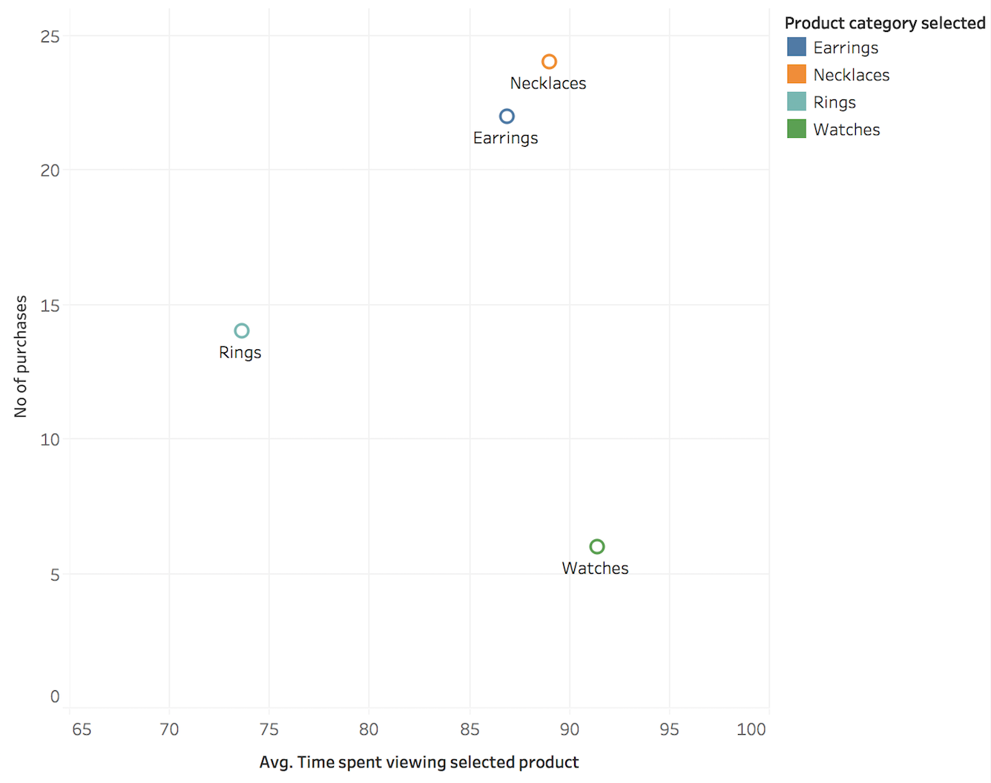
Purchases vs Avg time viewing products 1. From the given data, there is no specific trend to the purchase behavior. Avg time spent viewing watches is the highest when compared to other product categories, but the no of watch purchases made is the lowest. Whereas for Rings, the Avg time spent is less but purchases made higher than watches. For Earrings and Necklaces, the more the time spent , more purchases were made.

Slide 5
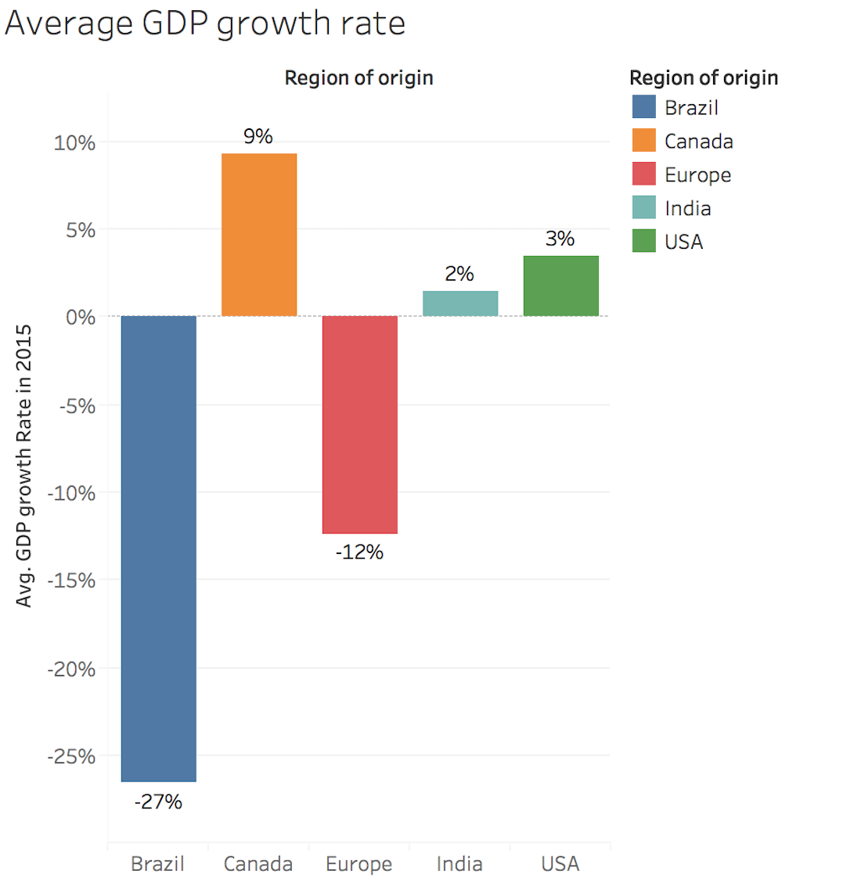
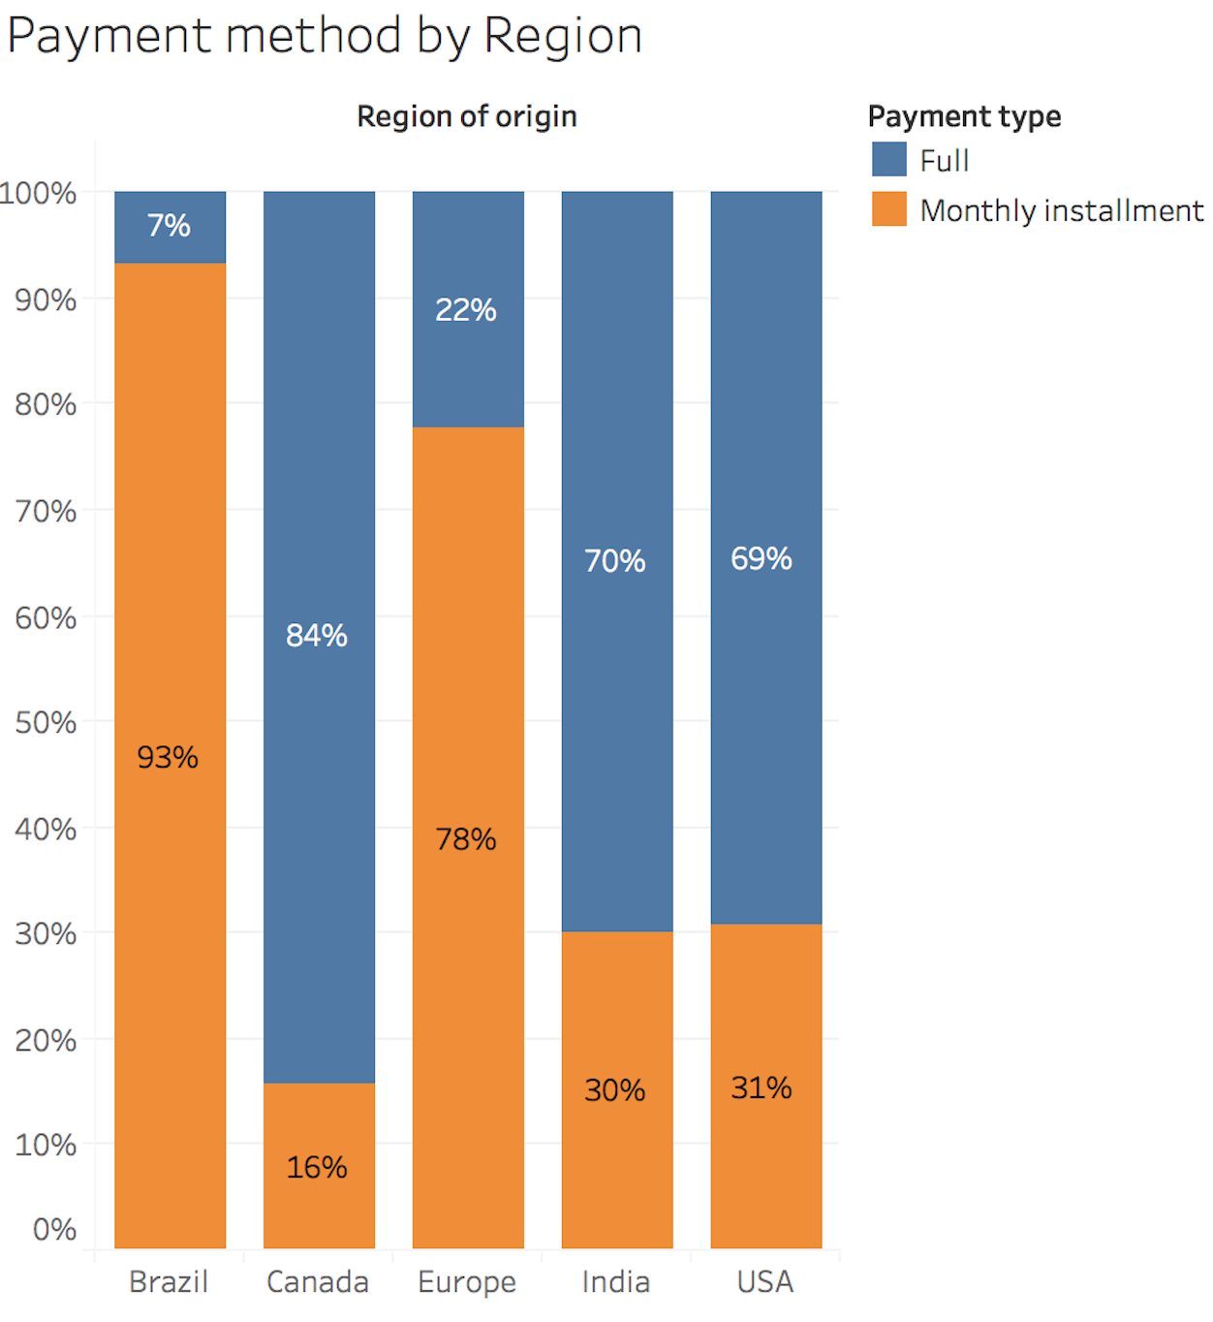
Relation of GDP data to Purchase data 1. We observe that the GDP of Brazil and Europe regions has decreased in comparison to 2014. And seems like there is a correlation between the GDP growth rates and the Payment methods used in the various regions.

Slide 6
Recommendations
We should focus our efforts where opportunity to increase conversions is highest.
From the funnel, we observe that 658 desired to buy an item from the chosen product categories and clicked add to cart. But only 66 out of 658 ended up making the purchase.
This tells us that the motivation to take action to make the purchase is being lost on the check out page.
Since payment form is pivotal ,we need to take appropriate actions to optimize our payment forms and checkout.
Since we provide two different payment method offerings, we need to have clear concise information about the two which can lead to better conversion rates.
From the data, we see that Mobile is widely used in all the regions to search and purchase Jewelry, and we should pay special attention to optimization for mobile specially the payment and checkout.
Additionally increase awareness by posting ads and making sure our site ranks well in Google search result pages which can potentially lead to increase in number of customers landing on the home page.

